Slide 1
Chemical bonding

Slide 2
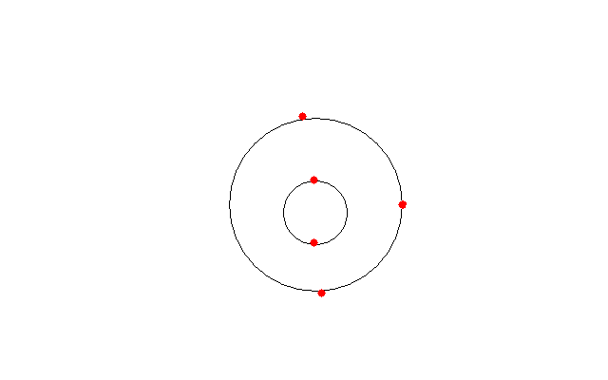
Structure of an atom
An atom is made of 3 things:
Protons which are positively charged (+1)
Neutrons are neutrally charged (0)
Electrons are negatively charged (-1)
The job of the protons and electrons are to cancel each other out so that the atom is not positively or negatively charged and the job of the neutrons are for mass.

Slide 3
Why do atoms need to join together?
Atoms need to join together because the aim of the atom is to get a full outer shell. When an atom has a full outer shell it is happy and the charge is neutral.

Slide 4
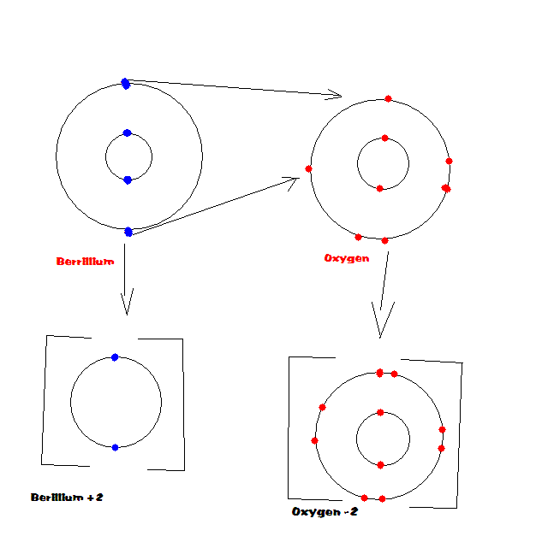
Ionic bonding
Ionic bonding is when a metal and a non metal give or take electrons to make a full outer shell.

Slide 5
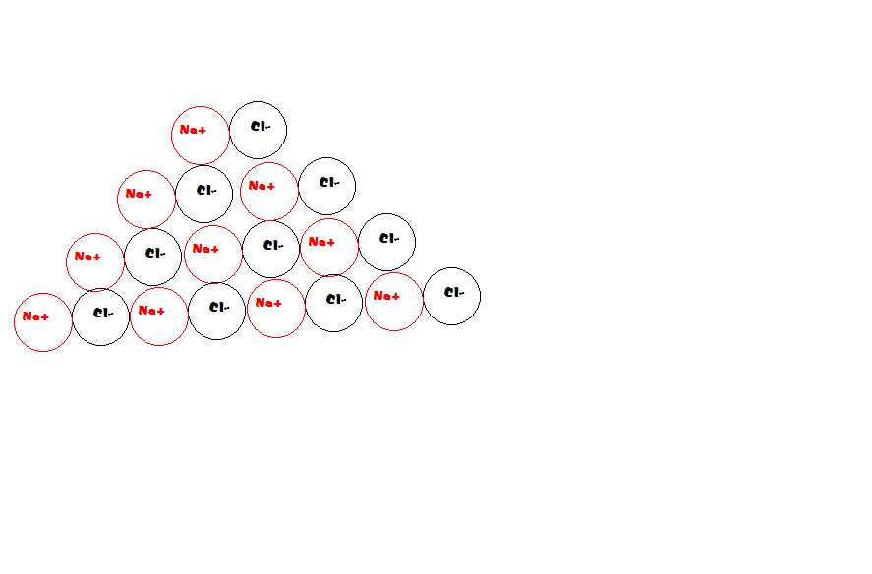
Giant ionic structures
Giant ionic structures are atom structures that cannot end because there will always be an atom without a full outer shell.

Slide 6
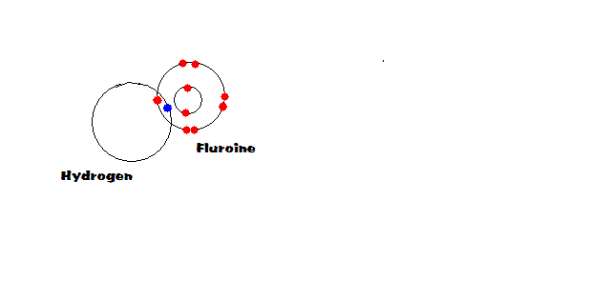
Covalent bonding
Covalent bonding is when the outer shells of two non metals atoms overlap so each other feel like they have a full outer shell.

Slide 7
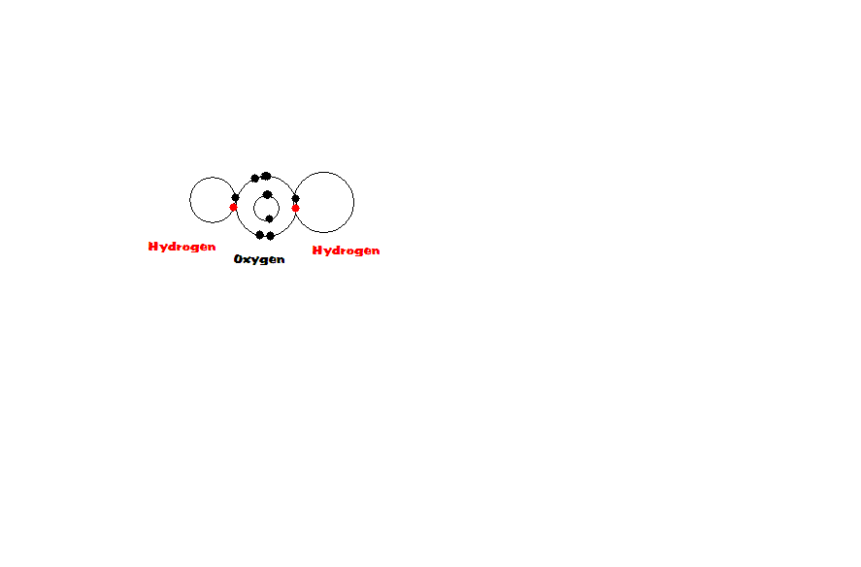
Simple molecular compounds
Simple molecular compounds are like covalent bonding but will only have a few atoms.

